Slide 1
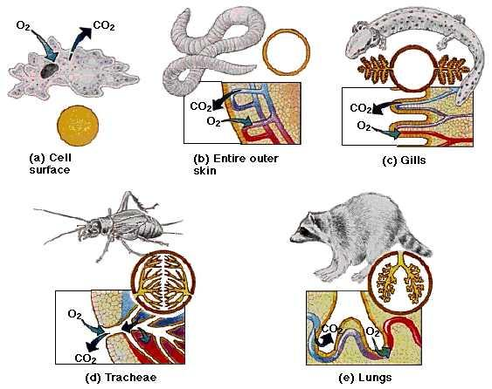
11ATAR Biology
Week 32
Gas Exchange in animals

Slide 2

Year 11 Biology Work Schedule
It is important to remain on schedule during this Semester.
Moodle
Have you visited Moodle this week? Yes / No
Tasks
Are you on schedule? Yes / No
When is your next task due?
U2T4 Topic Test
On Topic 4 – Multicellular Organisms
62 marks / 60 min
Multiple choice/short answer/1 Extended Answer

Slide 3
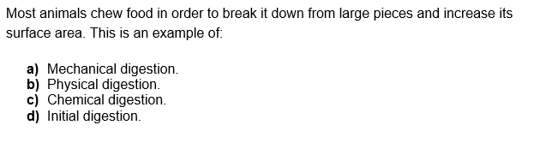
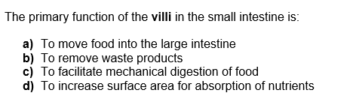
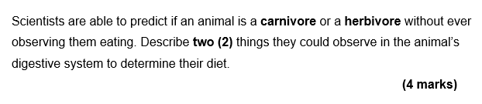
Review
Notes:
Teeth (1-2 marks):
Carnivores have canine teeth for tearing flesh (1)
Herbivore have large, flat molars for grinding plant material (1)
Jaw muscles (1-2 marks)
Carnivores have large upper jaw muscle of bite force (killing prey) (1)
Herbivores have large lower jar muscles for sideways movement/grinding of plant material (1)
Length of digestive tract (1-2 marks)
Carnivores have shorter digestive tract as meat is faster to digest (1)
Herbivores have longer digestive tract as cellulose in plant material takes a long time to break down (1)

Slide 4
Learning Intentions
Understand the structure and function of various animal respiratory systems.
Success Criteria
Describe the exchange of gases between the internal and external environments of the organism via specialised exchange surface(s), including spiracles, gills, alveoli and skin.
Identify features of efficient gas exchange surfaces.

Slide 5
Terminology
What is the difference between:
  Gas exchange –
  Cellular Respiration –

Slide 6
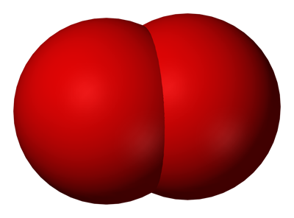
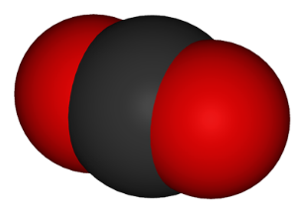
Gas Exchange - Overview
Cellular respiration
requires O₂ and produces CO₂ :
Gas exchange provides a means of supplying an organism with O₂ and removing the CO₂.
Gas exchange requires the surfaces of gas exchange to be ventilated (have oxygen brought over them).
C₆H₁₂O₆ + 6O₂ ➔ 6CO₂ + 6H₂O
glucose + oxygen ➔ carbon dioxide + water

Slide 7
Gas Exchange
Organism level
Circulatory system
Cellular level
Gas exchange surface
Fuel molecules
from food
Respiration
O₂
ATP
CO₂
CO₂

Slide 8
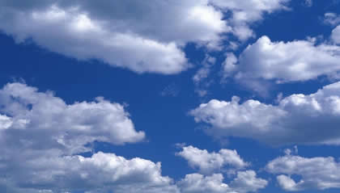

The Source of Oxygen
Air is about 21% oxygen (thinner at higher altitudes).
It is easy to ventilate.
The amount of oxygen in water varies but is always much less than air and even lower in warmer water.
It is harder to ventilate oxygen from water.
Notes:
The exchange between the atmosphere and the lungs or respiratory surface.

Slide 9
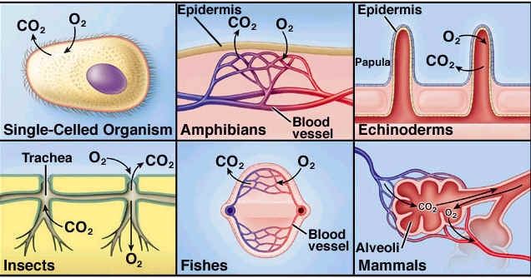
Gas Exchange Surfaces
Gases move by diffusion.
Diffusion is greater when:
  the surface area is large
  the distance travelled is small
  the concentration gradient is high
Gas exchange must be a moist surface
O₂ and CO₂ must be dissolved in water to diffuse across a membrane.

Slide 10
Gas Exchange Surfaces
Therefore, an efficient gas exchange surface will
  have a large surface area
  provide a small distance for gases to diffuse across
  be moist
  be organised or operate in a way that maintains a steep concentration gradient (high to low) for the diffusion of both O₂ and CO₂ gases.
The surface an organism has depends on:
  the size of the organism
  where it lives – water or land
  the metabolic demands of the organism – high, moderate or low

Slide 11
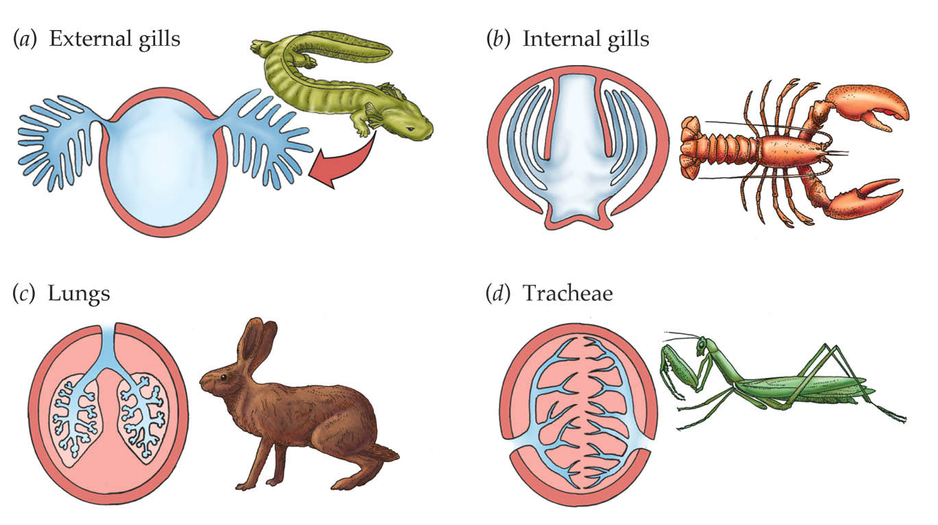
Types of Gas Exchange Surface
The four main types of gas exchange surfaces we will look at are:
  Through skin
  Gills
  Lungs
  Tracheae

Slide 12
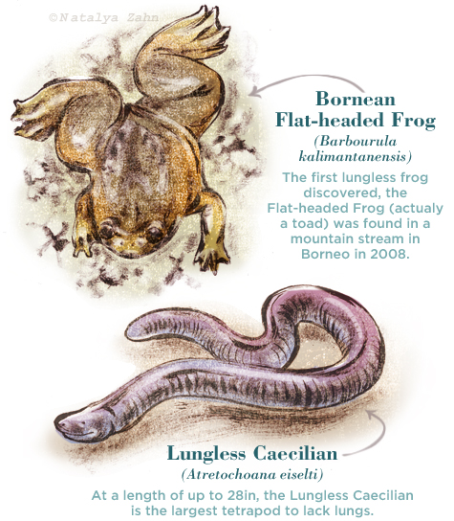
Gas Exchange – Simple Diffusion
Animals with small bodies exchange respiratory gases sufficiently through the body surface without specialized respiratory membranes.
Protists use direct diffusion into the cell to exchange gases.
Although most amphibians have lungs, they can also perform gas exchange directly through their highly vascularized skin. This means that their skin has lots of blood vessels going through it. Since the blood vessels are close to their permeable skin surface, diffusion can take place right through the skin.
Larger animals require an extended surface for gas exchange and a more complex respiratory system.
Notes:
In fact, some salamanders have no lungs at all, and they get all of their oxygen through their skin.

Slide 13
Gas Exchange in Water
Gas exchange in water has -
No problem in keeping the cell membranes of the gas exchange surface moist.
BUT
O₂ concentrations in water are low, especially in warmer and/or saltier water.
SO
The gas exchange system must be very efficient to get enough oxygen for respiration.
Notes:
Dissolved oxygen decreases exponentially as salt levels increase. That is why, at the same pressure and temperature, saltwater holds about 20% less dissolved oxygen than freshwater.

Slide 14
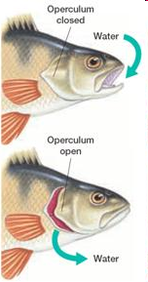
Gas Exchange in Water - Gills
Gas exchange in water requires gills.
Gills covered by an operculum (flap)
Fish ventilate their gills by alternately opening and closing mouth and operculum
➔ water flows into mouth
➔ over the gills
➔ out under the operculum
Notes:
Water difficult to ventilate so the gills are near surface of body

Slide 15
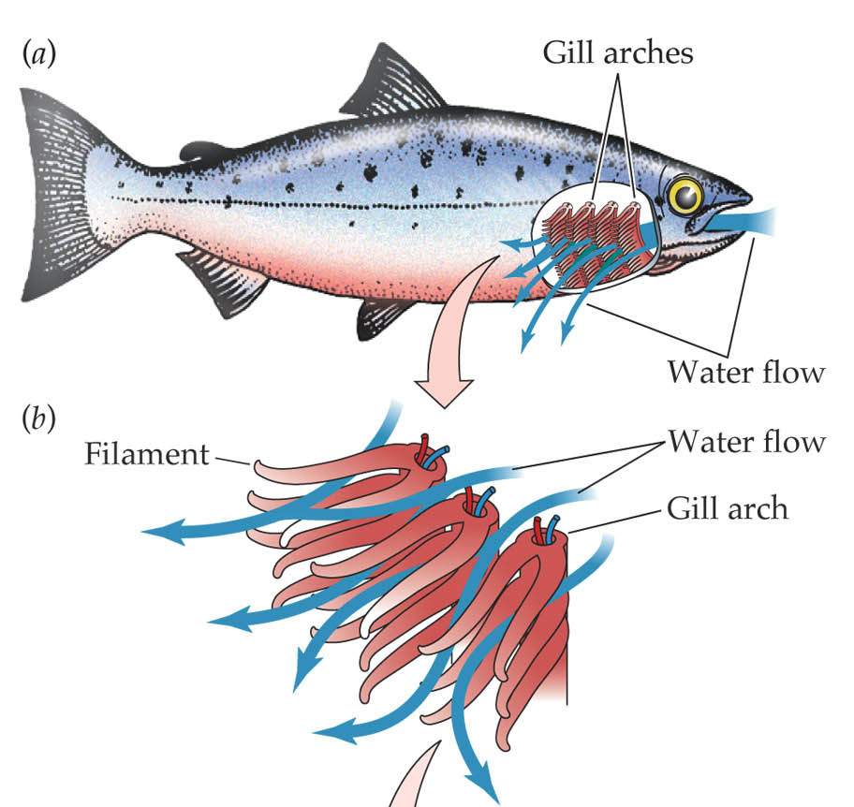
Gas Exchange in Water - Gills
In fish each gill is made of four bony gill arches.
Gill arches lined with hundreds of gill filaments that are very thin and flat.

Slide 16
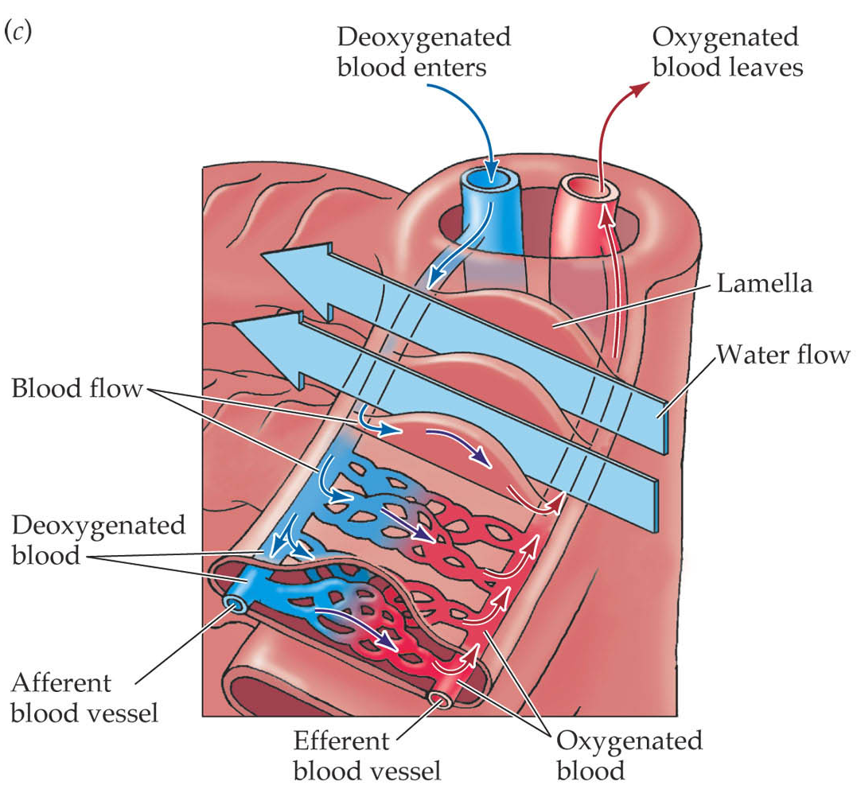
Gas Exchange in Water - Gills
Gill filaments have folds called lamellae that contain a network of capillaries.
Blood flows through the blood capillaries in the opposite direction to the flow of water.
Video on fish gas exchange https://www.youtube.com/watch?v=_2kjL9BV3SA
(~ 9 min)
Notes:
https://www.youtube.com/watch?v=_2kjL9BV3SA

Slide 17
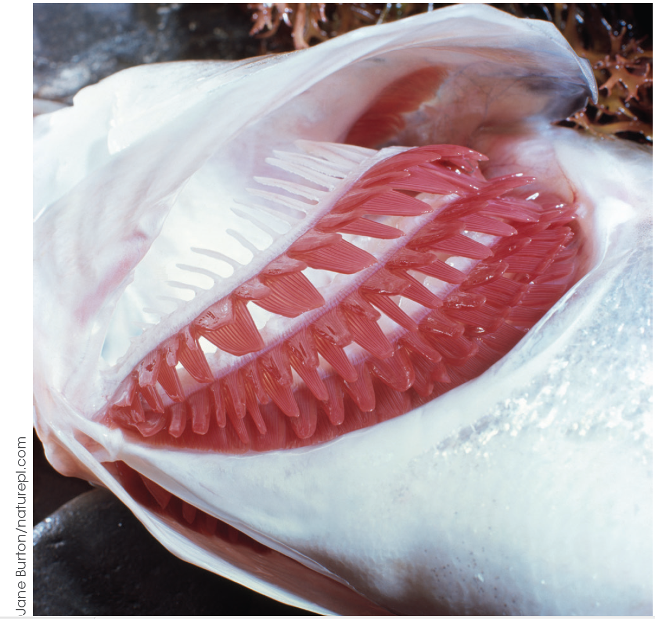
Gas Exchange in Water - Gills
The gill arch contains an artery that brings deoxygenated blood to the gill and each gill plate is well supplied by capillaries that branch from this artery.
As the water flowing over the gill has a higher concentration of O₂ and a lower concentration of CO₂, O₂ diffuses into the blood capillary and CO₂ diffuses out.
The oxygenated blood is carried away from the gill and the excess CO₂ is washed away from the gill by the incoming water.

Slide 18
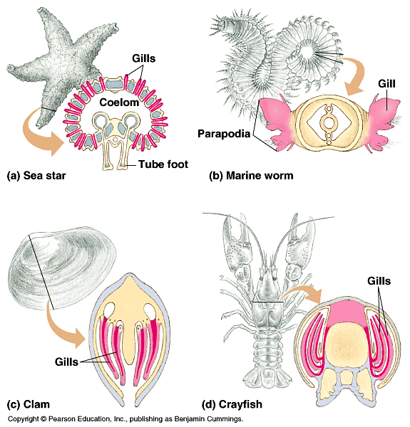
Gas Exchange in Water - Gills
Gills are efficient gas exchange surfaces because they:
Have a very large surface area created by the folding
Are thin-walled and in close contact with water to create short distance for diffusion
Have a very high blood supply to bring CO₂ and carry away O₂ ➔ dark red colour
Are moist: found in animals that live in water!

Slide 19
Gas Exchange in Air
For gas exchange, air has many advantages over water -
Air has a much higher oxygen concentration than water.
Diffusion occurs more quickly so less ventilation of the surface is needed.
Less energy is needed to move air through the respiratory system than water.
BUT
As the gas exchange surface must be moist, in terrestrial animals water is continuously lost from the gas exchange surface by evaporation.
SO
The gas exchange surface is folded into the body to reduce water loss.

Slide 20
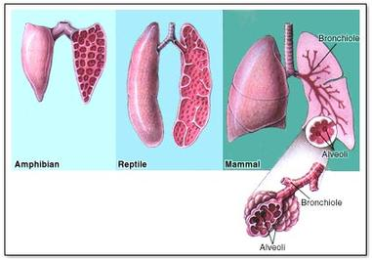
Gas Exchange in Air
Land animals (terrestrial animals) must get the oxygen from the air.
Many terrestrial animals have lungs.
Insects have a system known as the tracheae.

Slide 21
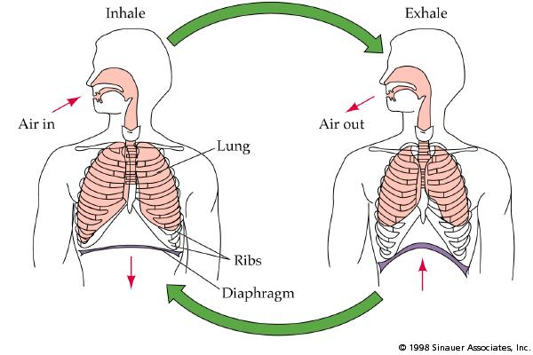
Gas Exchange in Air – Mammalian Lungs
Movement of the diaphragm and ribs causes the lungs to be ventilated for gas exchange.

Slide 22
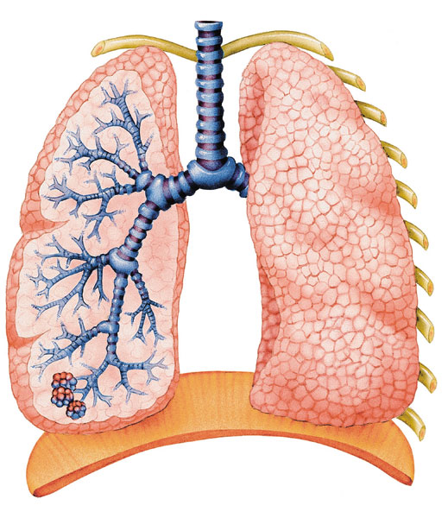
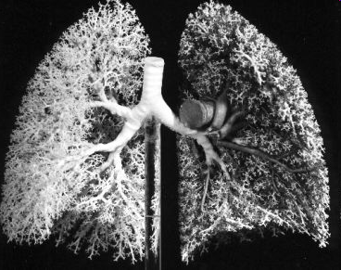
Gas Exchange in Air - Mammalian Lungs
Mammalian lungs have a system of tubes (held open by rings of cartilage) that allow air to flow in and out of the lungs.
Air enters via the trachea (windpipe).
Trachea branches into two bronchi (one bronchus to each lung).
Bronchi branch into bronchioles.

Slide 23
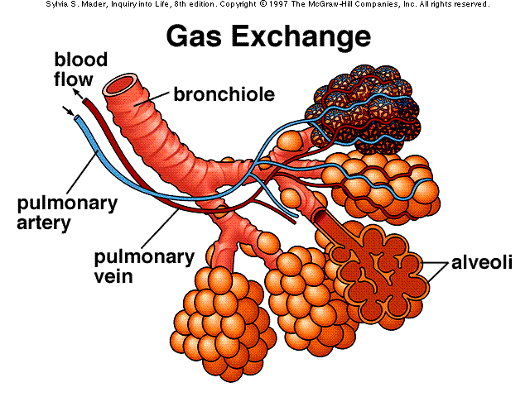
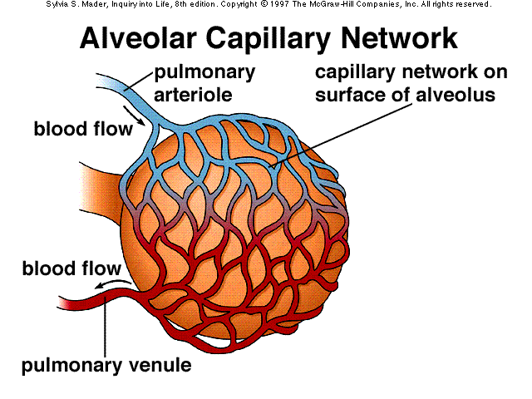
Gas Exchange in Air - Mammalian Lungs
Many alveoli at the end of the bronchioles.
Alveoli walls are made of flat cells which are only one cell thick.
Each alveolus is lined with moisture.
Surrounded by capillary network carrying blood.

Slide 24
Gas Exchange in Air - Mammalian Lungs
Air flows into and out of the lungs because of changes in the air pressure inside the lungs.
Expansion of the lungs increases their volume and thus decreases the intrapulmonary pressure.
  Air from outside the lungs rushes in in response to the pressure gradient.
When lung volume reduces during expiration, intrapulmonary pressure increases and air moves out through the mouth or nose.
Boyle’s law states that at a constant temperature, the pressure and volume of a gas are inversely proportional
i.e. as pressure increases the volume of a gas decreases. Increasing the volume increases the space between molecules and reduces pressure.
Decreasing the volume decreases the space between molecules and increases pressure.

Slide 25
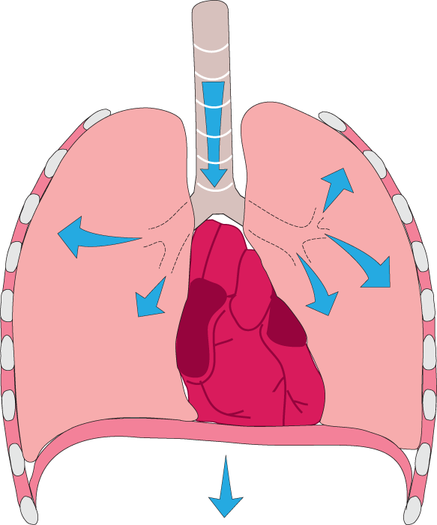
Gas Exchange in Air - Mammalian Lungs
1a
External intercostal muscles contract causing the ribcage to expand and move up
INSPIRATION – breathing in
During quiet breathing (at rest) inspiration is achieved by increasing the space (and therefore decreasing the pressure) inside the lungs.
Air then flows into the lungs in response to decreased pressure inside the lungs.
Inspiration is always an active process involving muscle contraction.
1b
Diaphragm contracts and moves down.
2a
Thoracic volume increases, lungs expand, and the pressure inside the lungs decreases
2b
Air flows into the lungs in response to the pressure gradient

Slide 26
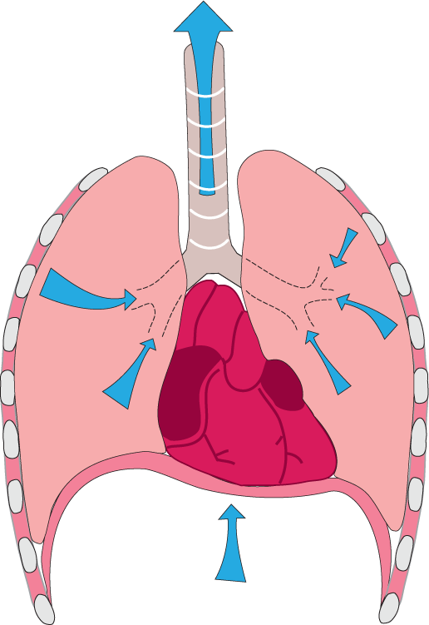
Gas Exchange in Air - Mammalian Lungs
1a
In quiet breathing, external intercostal muscles and the diaphragm relax. Elasticity of the lung tissue causes recoil.
EXPIRATION – breathing out
During quiet breathing, expiration is achieved passively by decreasing the space (and thus increasing the pressure) inside the lungs.
Air then flows passively out of the lungs to equalize with the air pressure.
In active breathing, muscle contraction is involved in bringing about both inspiration and expiration.
1b
In forced breathing the internal intercostals and abdominal muscles also contract to increase the force of expiration.
2
Thoracic volume decreases and the pressure inside the lungs increases.
3
Air flows passively out of the lungs in response to the pressure gradient

Slide 27
Gas Exchange in Air - Mammalian Lungs
Inhaled air: 21% O₂ and 0.04% CO₂
Blood arriving: low in O₂ and high in CO₂
Exhaled air: 17% O₂ and 4% CO₂
Blood leaving: high in O₂ and low in CO₂
O₂ in
lung air
dissolves in moist lining
diffuses into blood
diffuses into lung air
diffuses into moist lining
CO₂ in
blood

Slide 28
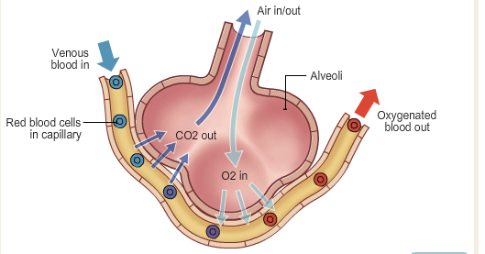
Gas Exchange in Air - Mammalian Lungs
Air arriving in the alveoli is high in O₂ and low CO₂, while the blood is low in O₂ and high in CO₂.
This establishes the concentration gradient which allows the diffusing of both gases in and out.
The constant new supply of air and blood to the area maintains the gradient.

Slide 29
Gas Exchange in Air - Mammalian Lungs
The maximum efficiency of the lungs for gas exchange are maintained by:
Large surface area
Many tiny alveoli
Very large surface area (as big as a tennis court in humans!)
Moist - wet lining of alveolus and an internal system to reduce water loss by evaporation
Short distance for diffusion as alveoli and capillary walls only one cell thick, cells are flattened so very thin and the capillaries pressed against alveoli
Maintaining a concentration gradient. The air (with depleted O₂ and excess CO₂) is exhaled ➔ replaced with fresh inhaled air and the blood (having lost CO₂ and been enriched with O₂) returns to heart to get pumped around body ➔replaced with blood collected from body.

Slide 30
Gas Exchange in Air - Mammalian Lungs
A must watch for you - excellent video of a lung dissection.
https://www.youtube.com/watch?v=9xhxALk9gm8
Model lung demonstration
https://www.youtube.com/watch?v=CBv2BqqAydE
Video on gas exchange at the alveoli
https://www.youtube.com/watch?v=AyUtdqiOgCA

Slide 31
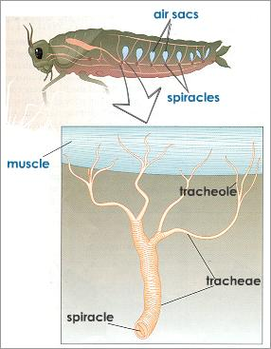
Gas Exchange in Air – Insect Tracheae
Insects have a completely different system.
Air tubules (trachea & tracheoles) throughout the body which open to the environment via spiracles.

Slide 32
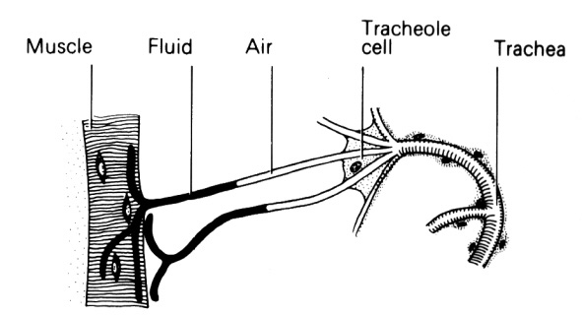
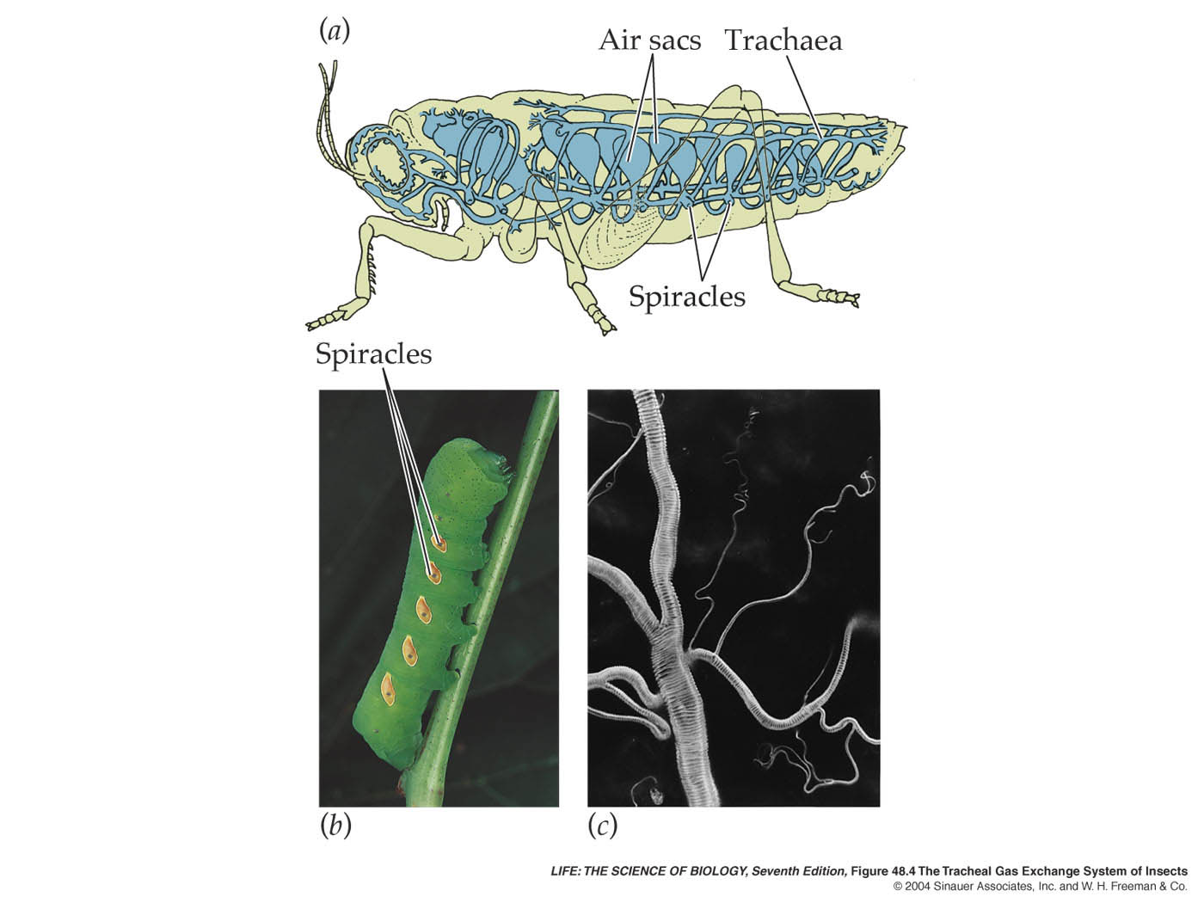
Gas Exchange in Air – Insect Tracheae
Trachea kept open by circular bands of chitin
Branch to form tracheoles that reach every cell.
Ends of the tracheoles are moist.
Oxygen delivered directly to respiring cells – insect blood does not carry oxygen.
Video showing the insect tracheal syste https://www.youtube.com/watch?v=quwhcgkVO3c

Slide 33
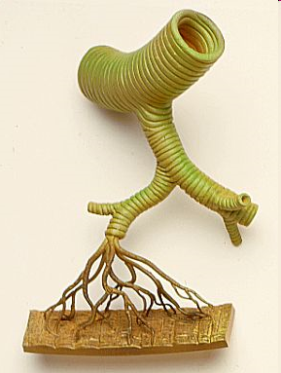
Gas Exchange in Air – Insect Tracheae
Tracheal system is an efficient method of gas exchange as
Oxygen is delivered directly to respiring cells.
Can pump body to move air around in tracheal system.
BUT
Size of animal is limited by relatively slow diffusion rate (reason why insects are so small).

Slide 34
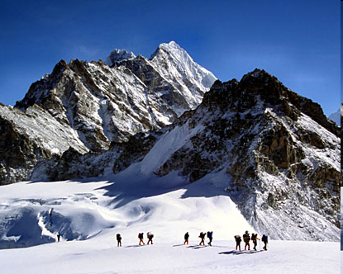
Gas Exchange in Air – Bird Lungs
Birds have a high demand for oxygen:
  They’re warm-blooded so metabolism is high.
  Flight requires a lot of energy.
Additional challenge:
  Air at higher altitude is
  thinner ➔ lower in O₂.
Some birds can still fly as high, eg. over Mt Everest!
Birds have a very efficient gas exchange system to cope with low O₂ supply & high O₂ demand.

Slide 35
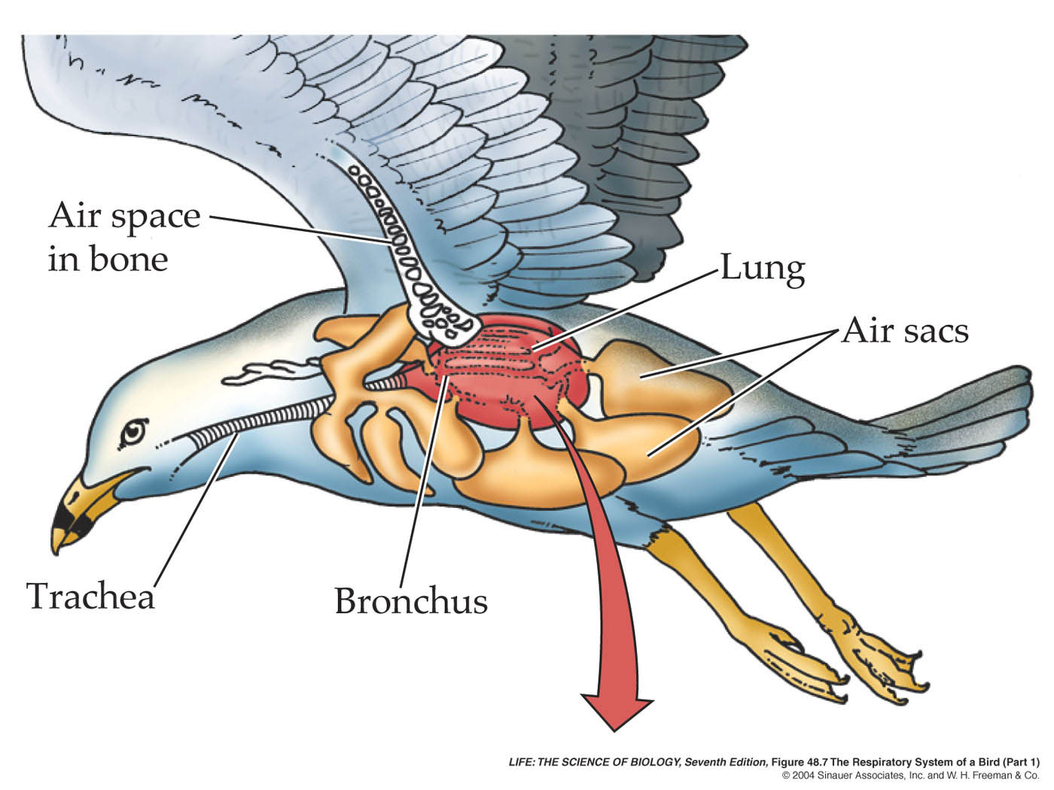
Gas Exchange in Air – Bird Lungs
Birds have lungs and air sacs.
Air sacs are not sites of gas exchange.
Air sacs enable a one-way flow of air through lungs.

Slide 36
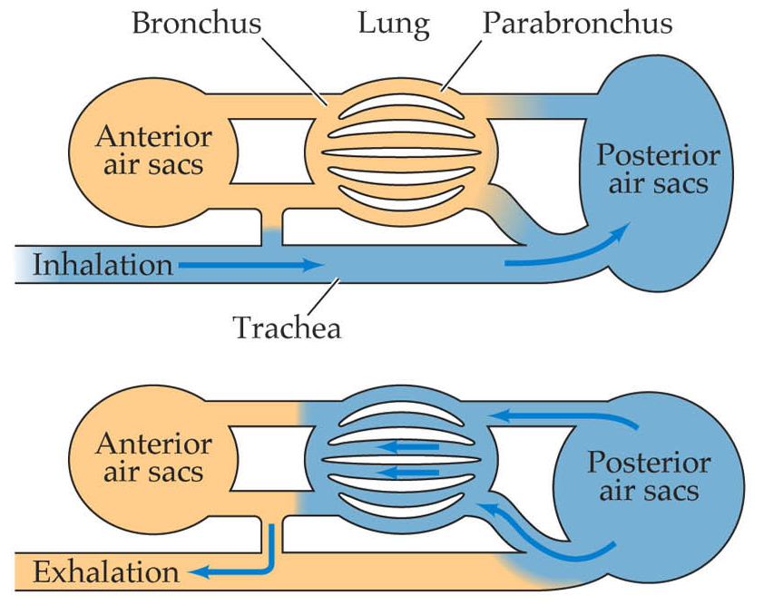
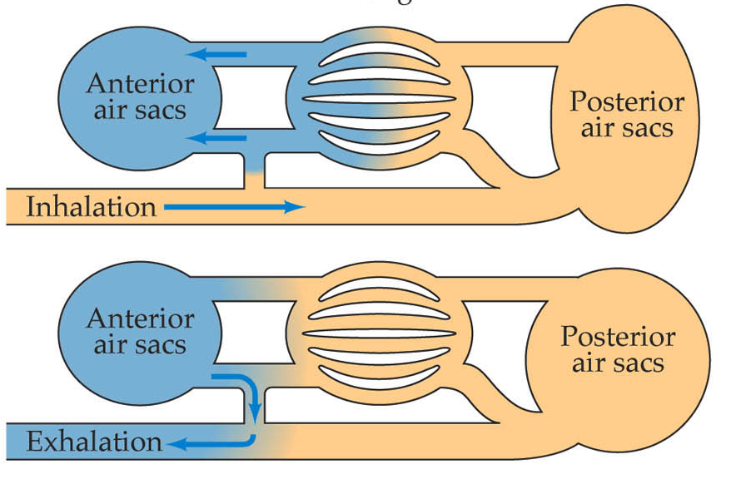
Gas Exchange in Air – Bird Lungs
Passage of air through lungs:
in trachea rear air sacs rear bronchi
parabronchi in lungs
out trachea front air sacs front bronchi

Slide 37
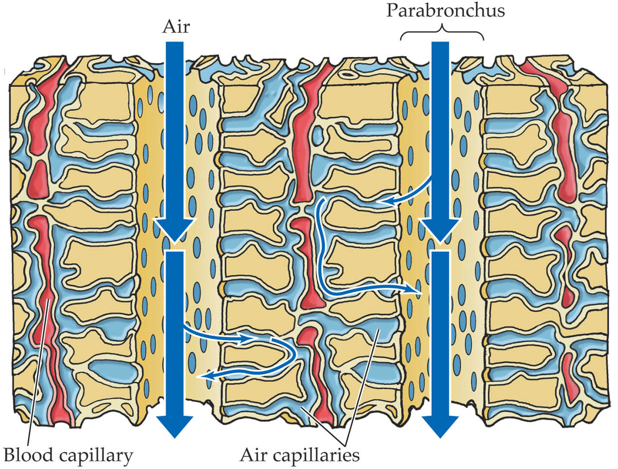
Gas Exchange in Air – Bird Lungs
The main air tubes through lungs are the parabronchi.
Tiny air capillaries loop away from and back to parabronchi ➔ one way flow of air.
Blood capillaries run alongside air capillaries.
The blood flows in opposite direction to air flow to create a counter-current exchange of gases, this maintains the concentration gradient.
Video showing gas exchange in bird lungs https://www.youtube.com/watch?v=kWMmyVu1ueY

Slide 38
Gas Exchange in Air – Bird Lungs
Features enhancing the efficiency of bird lungs are:
Large surface area
Many tiny air capillaries
Short distance for diffusion as the air and blood capillary walls made of flattened, thin cells and air & blood capillaries alongside each other.
Moist as the lining of air capillaries is wet and the system is internal to conserve moisture
Maintaining a concentration gradient as air flows in one direction through lungs regardless of whether the bird is inhaling or exhaling. The one way passage in both parabronchi and air capillaries; other way in blood capillaries creates the counter-current exchange.

Slide 39
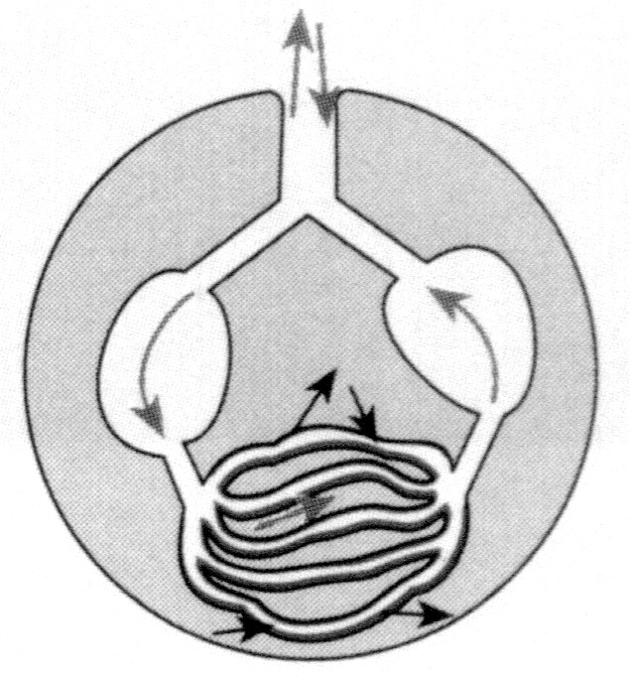
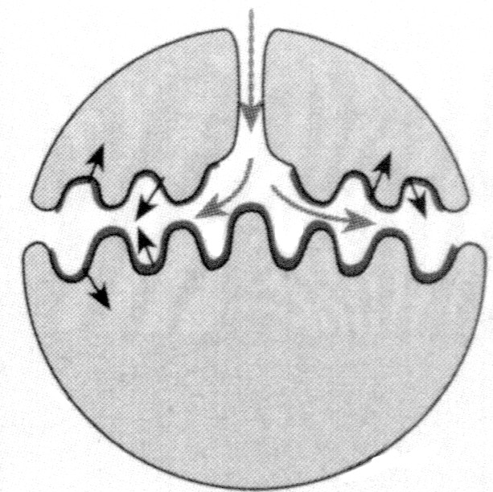
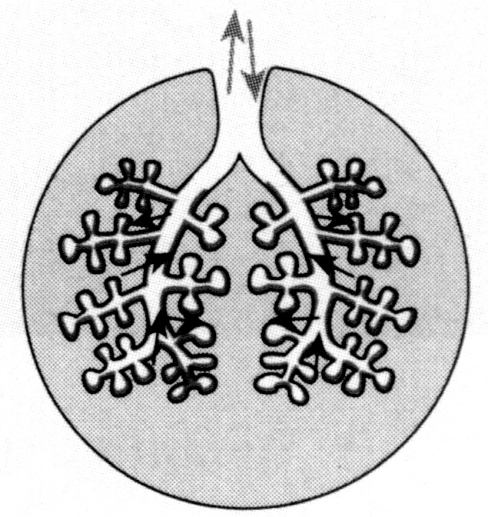
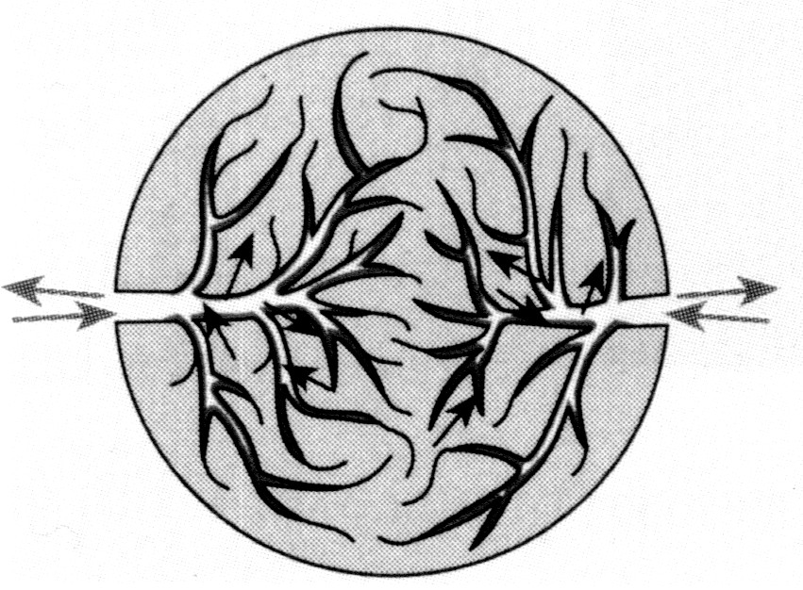
Comparison of Gas Exchange Systems
fish
gills
bird
lungs
mammal
lungs
insect
tracheae

Slide 40

Success Criteria
Describe the exchange of gases between the internal and external environments of the organism via specialised exchange surface(s), including spiracles, gills, alveoli and skin.
Identify features of efficient gas exchange surfaces.

Slide 41
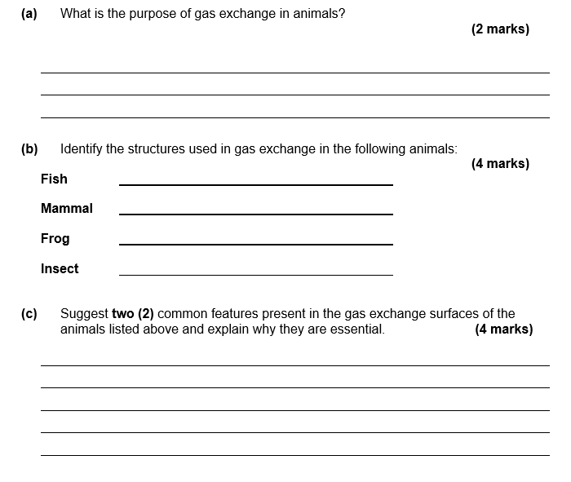
Exam Review Question
Notes:
Obtain oxygen and remove carbon dioxide (1) to enable cellular respiration to take place (1)
Fish – Gills comprised of gill lamellae (1)
Mammal – Lungs containing alveoli (1)
Frog – Lungs (with alveoli) and skin (1)
Insect – Spiracles and tracheal tubes (1)
Max 2 from:
Moist surface for gas exchange (fish already in water). (1)
Large surface area. (1)
Thin (1)
Max 2 from:
Oxygen must be dissolved first before it can be diffused into respiratory system. (1)
Increases the amount of oxygen that can be obtained in order to supply metabolic needs and CO2 excreted. (1)
Must be thin enough for gases to diffuse across (1)

Slide 42

Moodle & Textbook Work
Nelson Chapter 12: pages 390-396 and Moodle workbook.
Review various videos on each of the animal systems.

Slide 43
Student Feedback
What I learnt today…..
What I need to revise….

